Slide 1
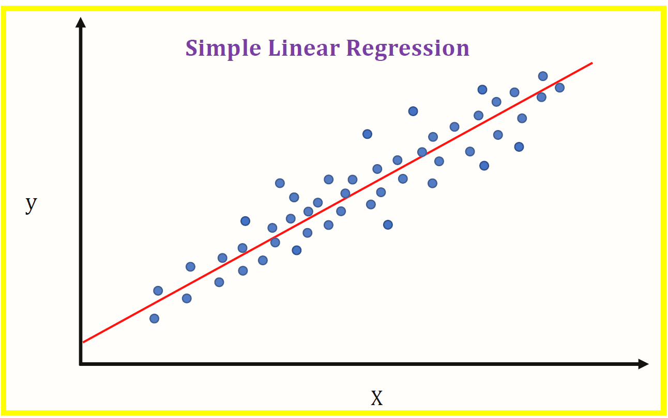
STUDENT MARKS PREDICTION
USING LINEAR REGRESSION
Divyam Arora
Anusha NIgam
Anubhav Choudhary

Slide 2

INTRODUCTION
Education is very important issue regarding development of a country. The main objective of educational institutions is to provide high quality education to its students. One way to accomplish this is by predicting student's academic performance and thereby taking early steps to improve student's performance and teaching quality.

Slide 3
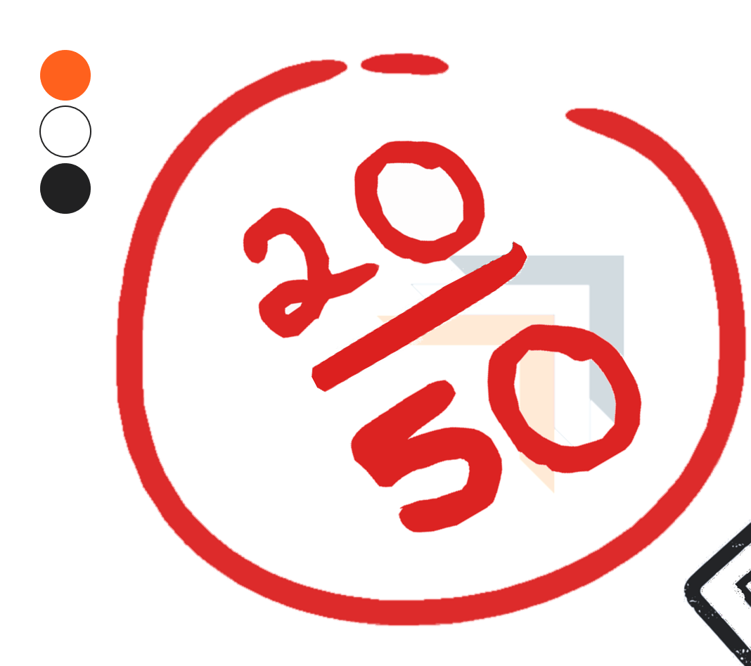
OBJECTIVE
This system aims to predict student's marks using linear regression. The idea behind this analysis is to predict the marks of students by their studying hours.Through this project we can determine:
How many hours need to do the study to get 99% marks
If I will do study x() hours per day so how much marks I will get.
Through these points the school can determine the performance of the student.

Slide 4

IMPLEMENTATION
To implement this model we are using Jupyter Notebook which is an open web source application.
Kaggle dataset is used for training the model.

Slide 5
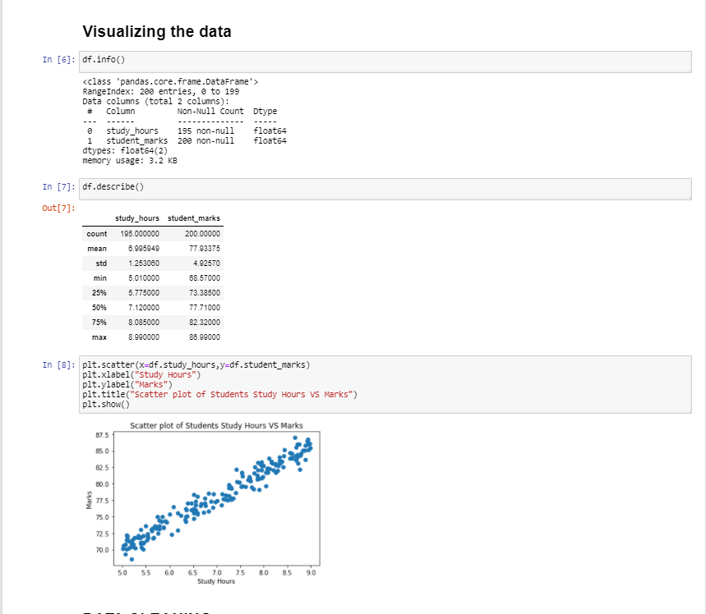
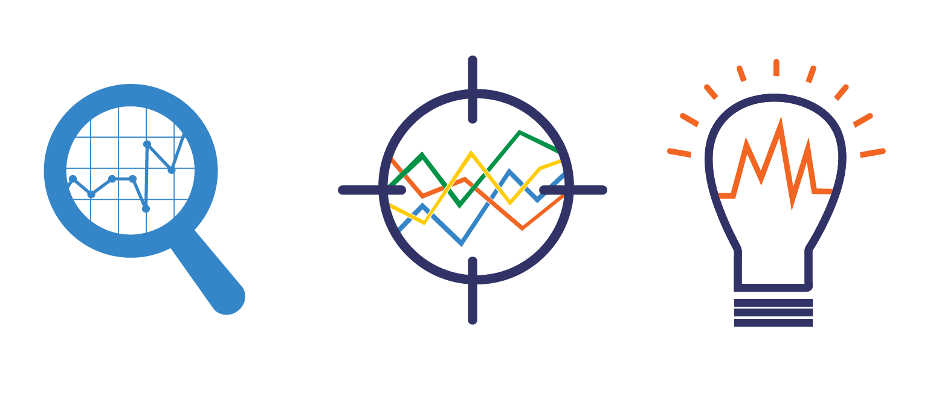
FLOW PROCESS
Gathering data
Data pre-processing →Visualisation

Slide 6
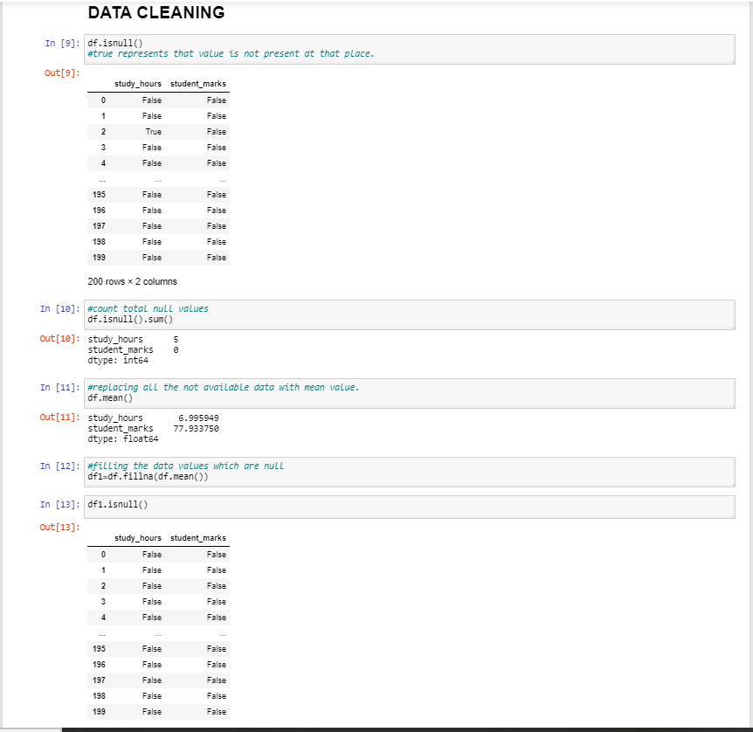

→Data Cleaning
4. Researching the model that will be best for the type of data, in this case Linear Regression.

Slide 7
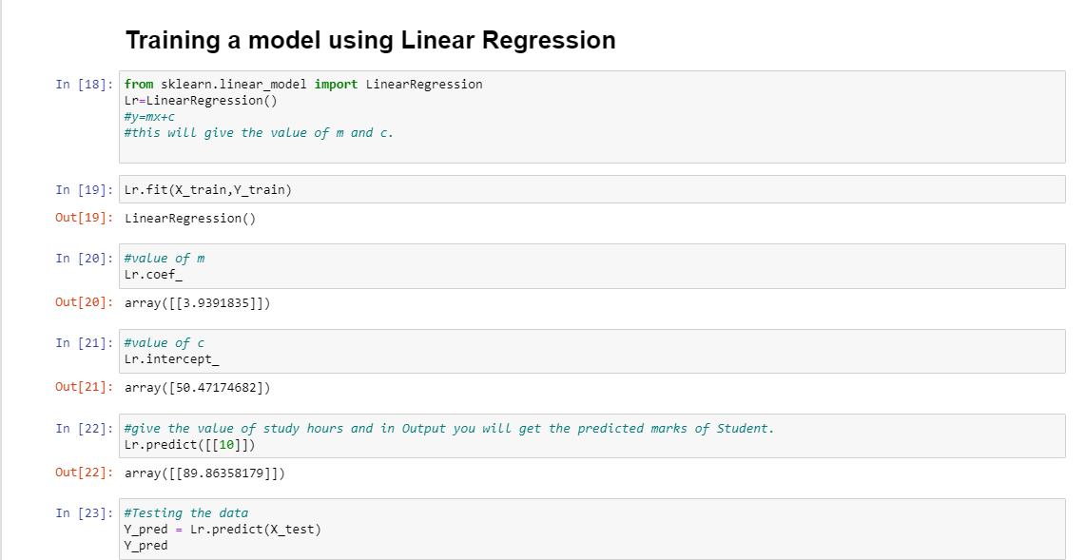
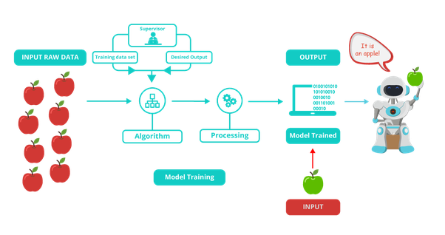
5.Training and testing the model

Slide 8

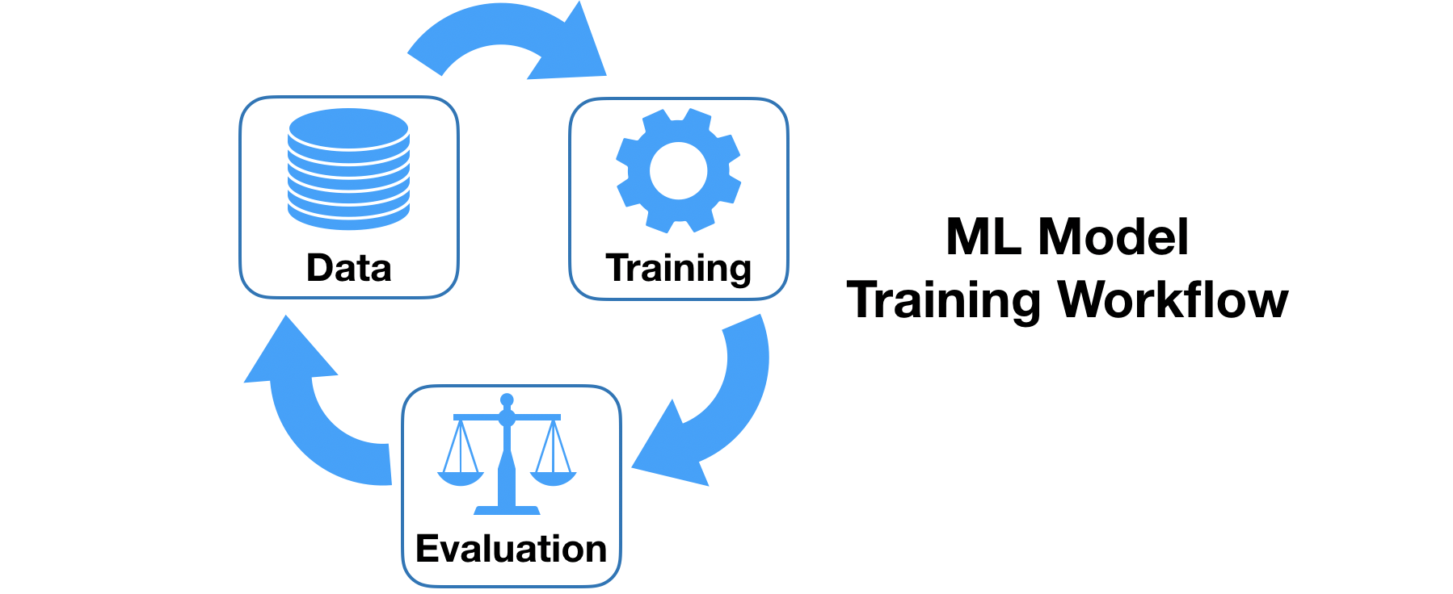
6. Evaluation– We got 95% accuracy after training the model.

Slide 9



LIBRARIES USED
Numpy
Pandas
Sklearn.model_selection
Sklearn.linear_model
Matplotlib

Slide 10
EVALUATION
Model Evaluation is an integral part of the model development process.
For evaluation, we utilize a partition of the refined data, usually referred to as the ‘test data’.
The calculated accuracy of the model is: 95%

Slide 11
THANK YOU

